Slide 1
Optimization on black-box function by parameter shift rule (PSR)
Vu Tuan Hai
Faculty of Software Engineering

Slide 2
Outline
Problem
Backgrounds
Methods
Results

Slide 3
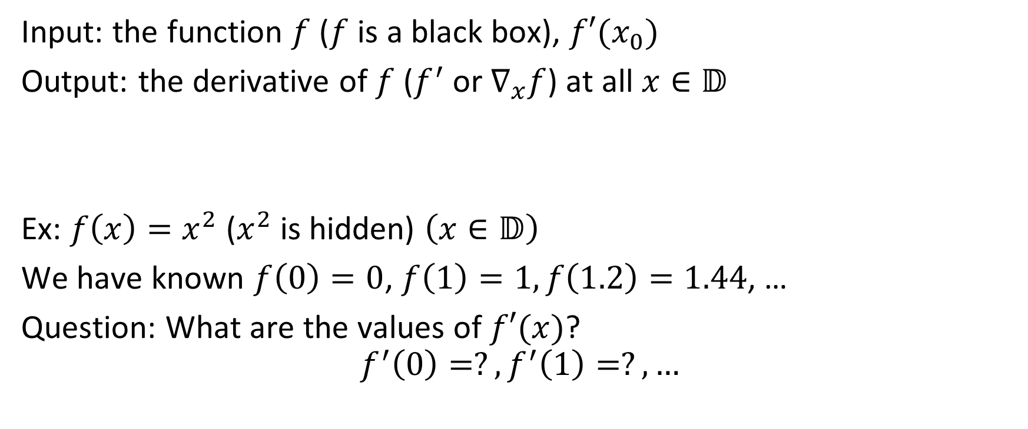
1. Problem
Input: the function $f$ ($f$ is a black box), $f′(x_{0})$
Output: the derivative of $f$ ($f^{′}$ or $∇_{x}f$) at all $x∈𝔻$
Ex: $f\left(x\right)=x^{2}$ ($x^{2}$ is hidden) $\left(x∈𝔻\right)$
We have known $f\left(0\right)=0$, $f\left(1\right)=1,f\left(1.2\right)=1.44$, …
Question: What are the values of $f′(x)$?
$$f^{′}\left(0\right)=?,f^{′}\left(1\right)=?,…$$

Slide 4

1. Problem: Example
Input:
Output:
x | f(x)
0 | 0
0.1 | 0.01
0.2 | 0.04
0.3 | 0.09
… | …
5 | 25
x | f’(x)
0 | ?
0.1 | ?
0.2 | ?
0.3 | ?
… | …
… | …
And $f’(3) = 6$

Slide 5
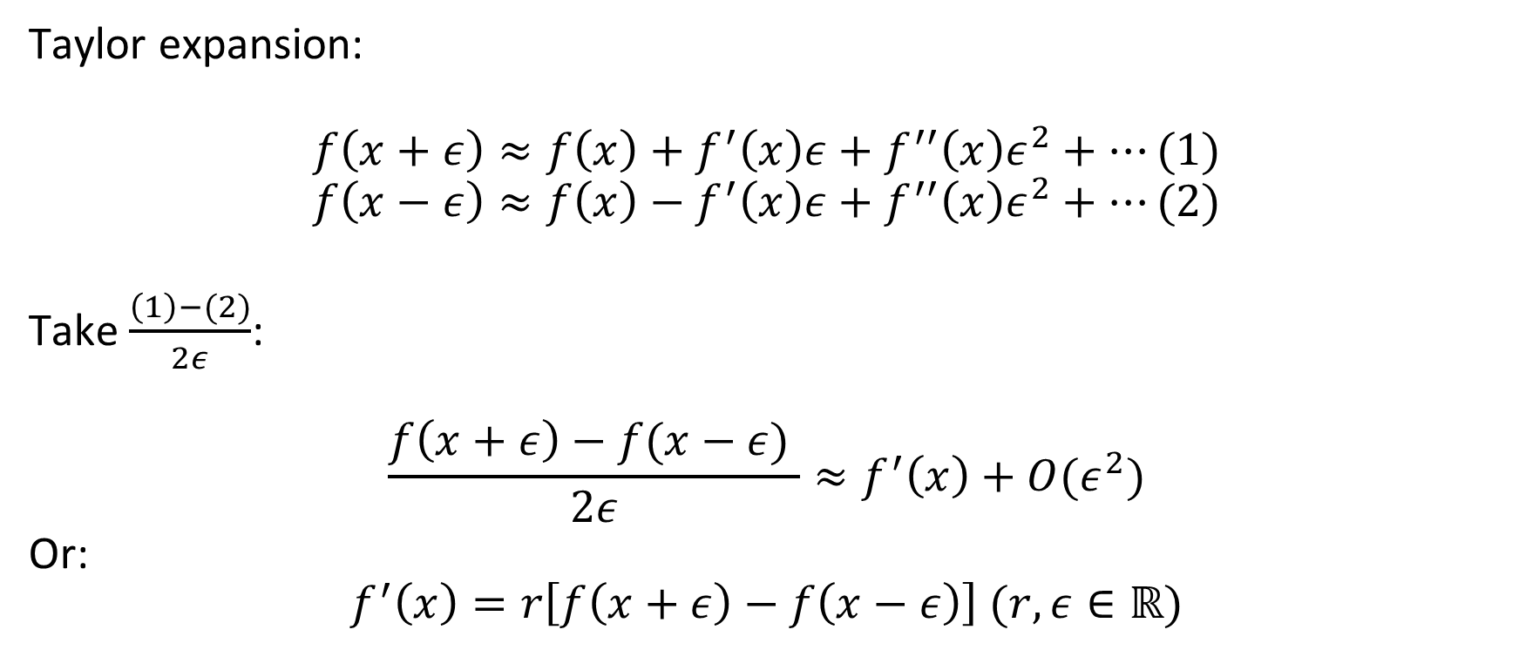
2. Backgrounds: Numerical differentiation
Taylor expansion:
$$f\left(x+ε\right)≈f\left(x\right)+f^{′}\left(x\right)ε+f^{′′}\left(x\right)ε^{2}+…(1)$$
$$f\left(x−ε\right)≈f\left(x\right)−f^{′}\left(x\right)ε+f^{′′}\left(x\right)ε^{2}+…(2)$$
Take $\frac{\left(1\right)−(2)}{2ε}$:
$$\frac{f\left(x+ε\right)−f(x−ε) }{2ε}≈f^{′}\left(x\right)+O(ε^{2})$$
Or:
$$f^{′}\left(x\right)=r\left[f\left(x+ε\right)−f\left(x−ε\right)\right] (r,ε∈ℝ)$$

Slide 6

2. Backgrounds: Numerical differentiation
Ex1: $f\left(x\right)=x^{2}$
$$f′\left(x\right)=r({\left(x+ε\right)}^{2}−{\left(x−ε\right)}^{2})=r\left(4xε\right)={\left(x^{2}\right)}^{′}=2x$$
$$⇒r=\frac{1}{2ε},ε∈ℝ\backslash \{0\}$$
Ex2: $f\left(x\right)=\sin{x}$
$$⇒r=\frac{1}{2sin{(ε)}},ε∈ℝ\backslash \{0\}$$

Slide 7

2. Backgrounds: Numerical differentiation
Ex2: $f\left(x\right)=sin⁡x$
Solve eq: $r\left[f\left(x+ε\right)−f\left(x−ε\right)\right]=\sin{′x}=cos⁡x$
$⇒2rcos\left(x\right)sin\left(ε\right)=\cos{x}$
$⇒2r\sin{ε}=1$

Slide 8
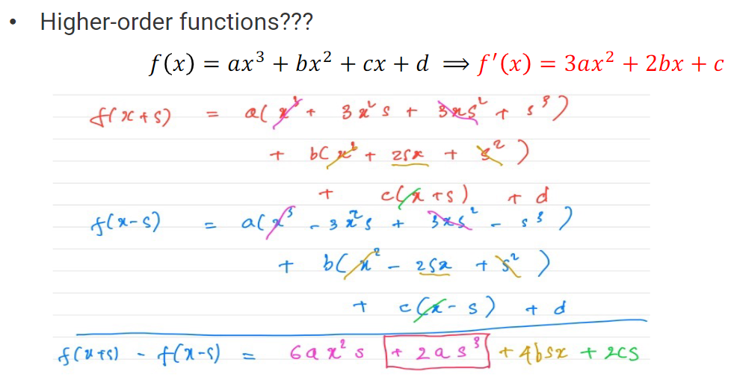
2. Backgrounds: Numerical differentiation

Slide 9
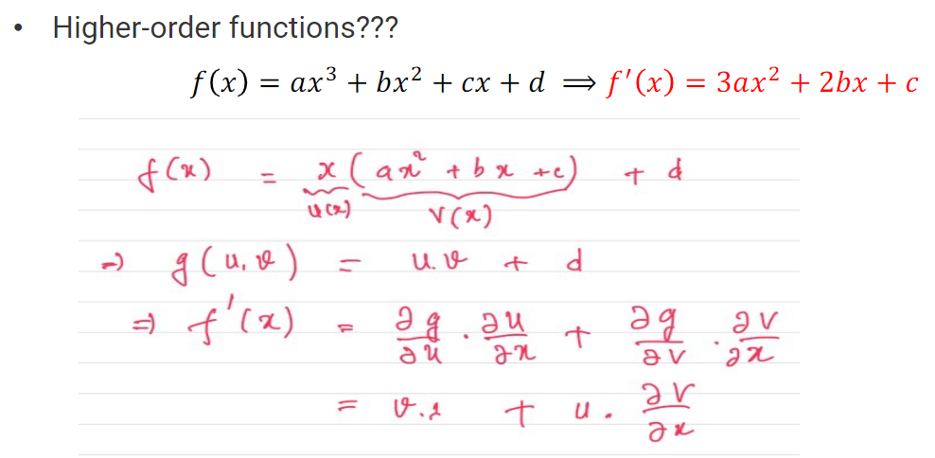
2. Backgrounds: Numerical differentiation

Slide 10
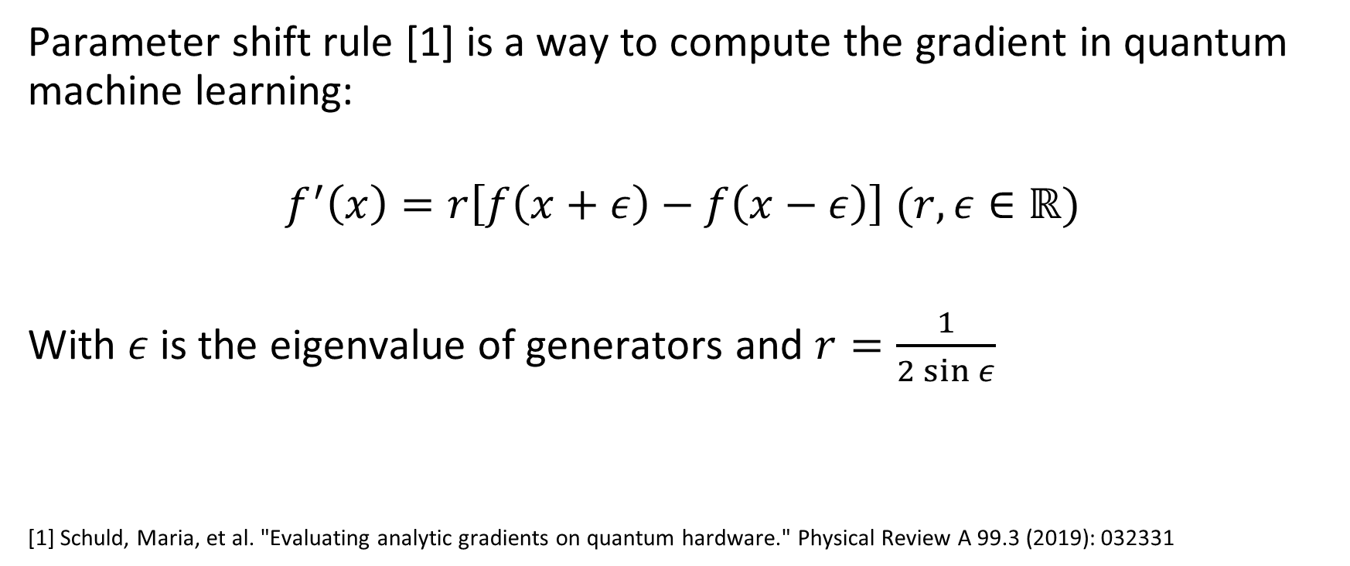
2. Backgrounds: Parameter shift rule (PSL)
Parameter shift rule [1] is a way to compute the gradient in quantum machine learning:
$$f^{′}\left(x\right)=r\left[f\left(x+ε\right)−f\left(x−ε\right)\right] (r,ε∈ℝ)$$
With $ε$ is the eigenvalue of generators and $r=\frac{1}{2\sin{ε}}$
[1] Schuld, Maria, et al. "Evaluating analytic gradients on quantum hardware." Physical Review A 99.3 (2019): 032331

Slide 11



3. Methods [1]
0
1
2
3
4
$$r$$
1
Grid search
Complexity: $O\left(n^{2}\right)$
[1] https://en.wikipedia.org/wiki/Hyperparameter_optimization
2
3
4
$$s$$

Slide 12


Grid search: Example
Output:
Input: $f\left(x\right)=sin⁡(x)$($sin⁡(x)$ is hidden),
x | f(x)
0 | 0
0.1 | 0.099
0.2 | 0.198
0.3 | 0.295
… | …
5 | -0.95
x | f’(x)
0 | ?
0.1 | ?
0.2 | ?
0.3 | ?
… | …
… | …
And $f’(\frac{π}{3}) =0.5$ ($\cos{\frac{π}{3}}=0.5)$

Slide 13


$\left|\cos\left(\frac{π}{3}\right)−0.8\left[(\sin\left(\frac{π}{3}+0.2\right)−sin⁡(\frac{π}{3}−0.2)\right]\right|$
Example
 | 0 | 0.2 | 0.4 | 0.6 | 0.8
0 | 0.8660254 | 0.8660254 | 0.8660254 | 0.8660254 | 0.8660254
0.2 | 0.8660254 | 0.82629154 | 0.78814174 | 0.75309691 | 0.72255419
0.4 | 0.8660254 | 0.78655767 | 0.71025807 | 0.64016841 | 0.57908297
0.6 | 0.8660254 | 0.74682381 | 0.6323744 | 0.52723992 | 0.43561175
0.8 | 0.8660254 | 0.70708994 | 0.55449073 | 0.41431143 | 0.29214053
r
$$ε$$
Loss $= \left|f′\left(\frac{π}{3}\right)−r\left[(f\left(\frac{π}{3}+ε\right)−f⁡(\frac{π}{3}−ε)\right]\right|$

Slide 14
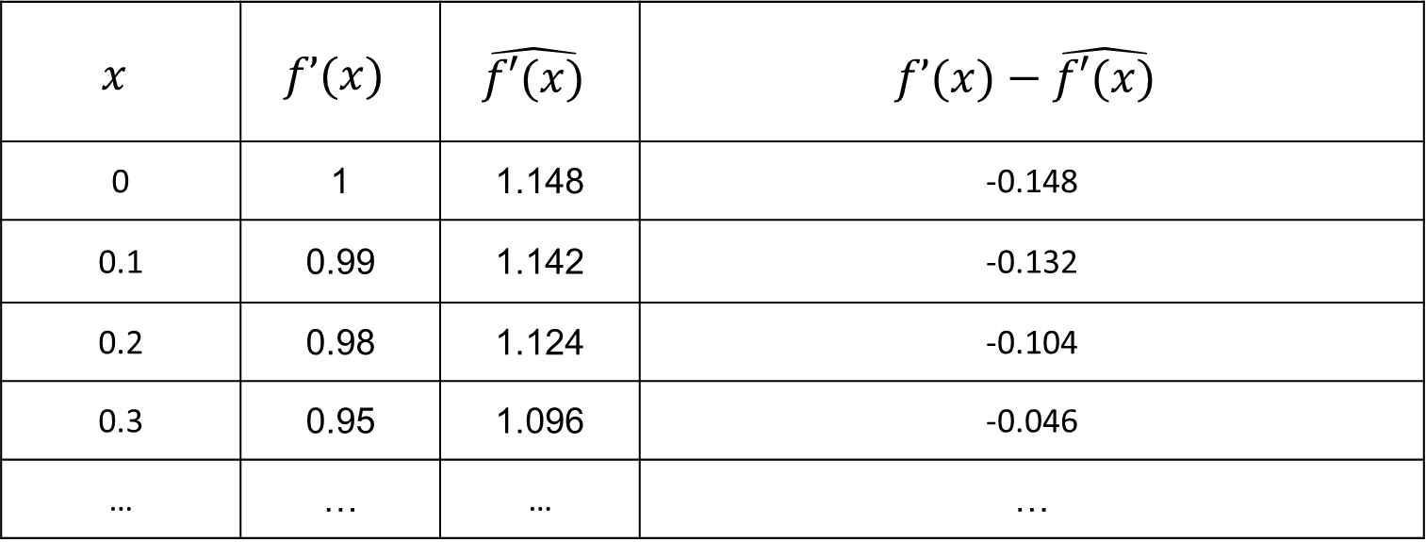
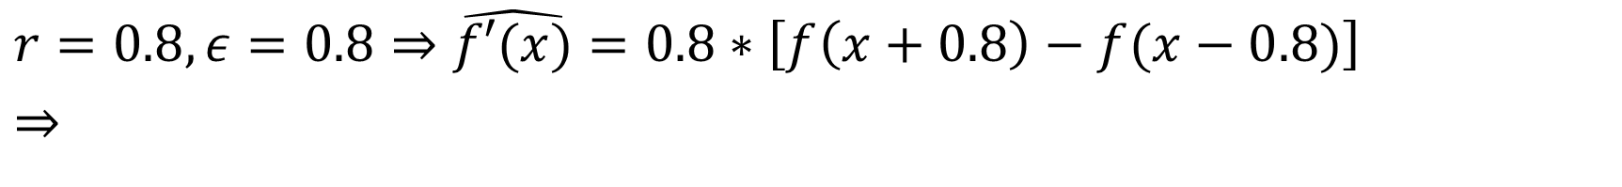
Example
$r=0.8,ε=0.8⇒$ $\hat{f′(x)}=0.8∗\left[f\left(x+0.8\right)−f(x−0.8)\right]$
$⇒$
$$x$$ | $$f’(x)$$ | $$\hat{f′(x)}$$ | $$f’(x)−\hat{f′(x)}$$
0 | 1 | 1.148 | -0.148
0.1 | 0.99 | 1.142 | -0.132
0.2 | 0.98 | 1.124 | -0.104
0.3 | 0.95 | 1.096 | -0.046
… | … | … | …
$$\text{Loss} =\frac{1}{N}\sum{\left|\frac{f’(x)−\hat{f′(x)}}{f′(x)}\right|}=\frac{1}{4}\left(\left|\frac{\text{−}\text{0.148}}{1}\right|+\left|\frac{\text{−}\text{0.1}32}{0.99}\right|+\left|\frac{−\text{0.1}04}{0.98}\right|+\left|\frac{\text{−}\text{0.}046}{0.95}\right|\right)=0.108=10.8\%$$

Slide 15
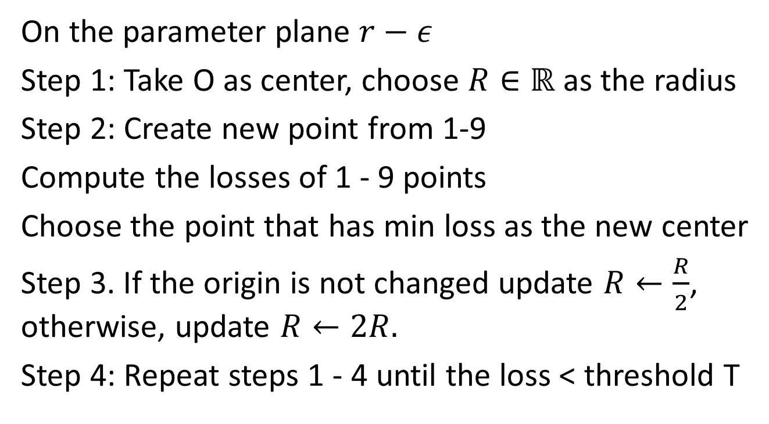
3. Our new method: Grid-Bubble (GB) search
On the parameter plane $r−ε$
Step 1: Take O as center, choose $R∈ℝ$ as the radius
Step 2: Create new point from 1-9
Compute the losses of 1 - 9 points
Choose the point that has min loss as the new center
Step 3. If the origin is not changed update $R←\frac{R}{2}$, otherwise, update $R←2R.$
Step 4: Repeat steps 1 - 4 until the loss < threshold T
1
2
3
4
5
6
7
8
9

Slide 16
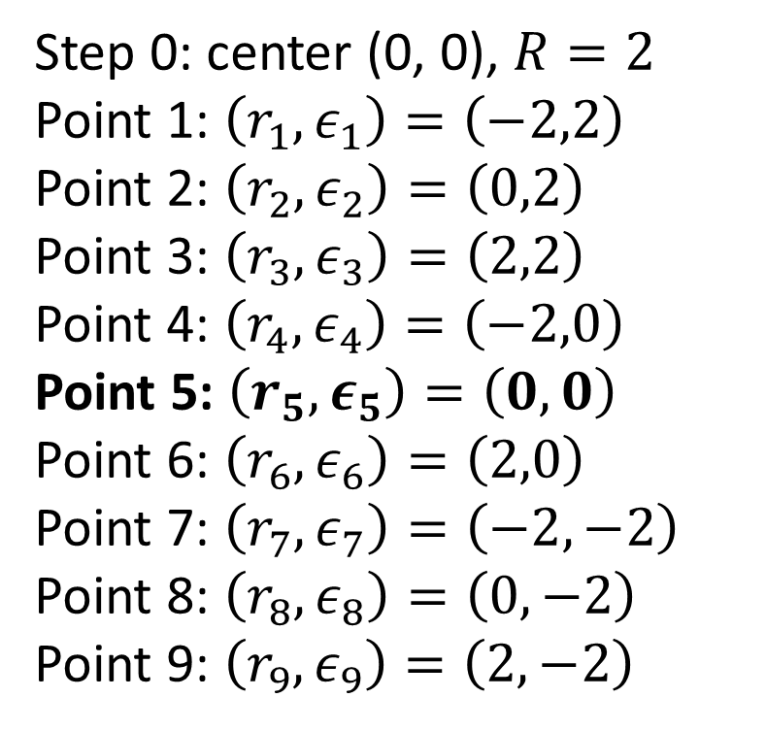

Iteration 1
Step 0: center (0, 0), $R=2$
Point 1: $\left(r_{1},ε_{1}\right)=\left(−2,2\right)$
Point 2: $\left(r_{2},ε_{2}\right)=\left(0,2\right)$
Point 3: $\left(r_{3},ε_{3}\right)=\left(2,2\right)$
Point 4: $\left(r_{4},ε_{4}\right)=\left(−2,0\right)$
Point 5: $\left(r_{5},ε_{5}\right)=\left(0,0\right)$
Point 6: $\left(r_{6},ε_{6}\right)=\left(2,0\right)$
Point 7: $\left(r_{7},ε_{7}\right)=\left(−2,−2\right)$
Point 8: $\left(r_{8},ε_{8}\right)=\left(0,−2\right)$
Point 9: $\left(r_{9},ε_{9}\right)=\left(2,−2\right)$
Loss 1$=2.31$
Loss 2$=0.5$
Loss 3$=1.31$
Loss 4$=0.5$
Loss 5$=0.5$
Loss 6$=0.5$
Loss 7$=1.31$
Loss 8$=0.5$
Loss 9$=2.31$
$\left|\cos\left(\frac{π}{3}\right)−2\left[(\sin\left(\frac{π}{3}+(−2)\right)−sin⁡(\frac{π}{3}−(−2))\right]\right|$

Slide 17
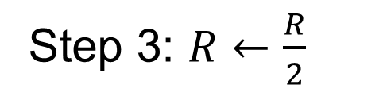
Iteration 1
(2,2)
Step 3: $R←\frac{R}{2}$
(1,1)
(0,0)
(-1,-1)
(-2,-2)

Slide 18
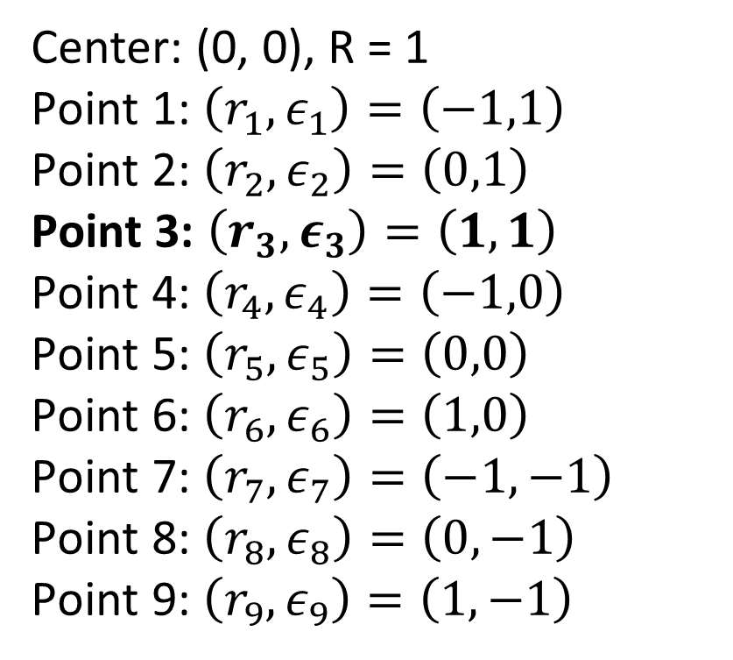
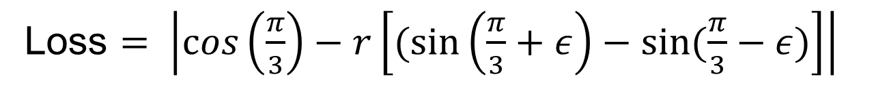

Iteration 2
Step 2
Center: (0, 0), R = 1
Point 1: $\left(r_{1},ε_{1}\right)=\left(−1,1\right)$
Point 2: $\left(r_{2},ε_{2}\right)=\left(0,1\right)$
Point 3: $\left(r_{3},ε_{3}\right)=\left(1,1\right)$
Point 4: $\left(r_{4},ε_{4}\right)=\left(−1,0\right)$
Point 5: $\left(r_{5},ε_{5}\right)=\left(0,0\right)$
Point 6: $\left(r_{6},ε_{6}\right)=\left(1,0\right)$
Point 7: $\left(r_{7},ε_{7}\right)=\left(−1,−1\right)$
Point 8: $\left(r_{8},ε_{8}\right)=\left(0,−1\right)$
Point 9: $\left(r_{9},ε_{9}\right)=\left(1,−1\right)$
Loss 1$=1.34$
Loss 2$=0.5$
Loss 3$=0.$34
Loss 4$=0.5$
Loss 5$=0.5$
Loss 6$=0.5$
Loss 7$=0.34$
Loss 8$=0.5$
Loss 9$=1.34$
Loss $= \left|\cos\left(\frac{π}{3}\right)−r\left[(\sin\left(\frac{π}{3}+ε\right)−sin⁡(\frac{π}{3}−ε)\right]\right|$

Slide 19
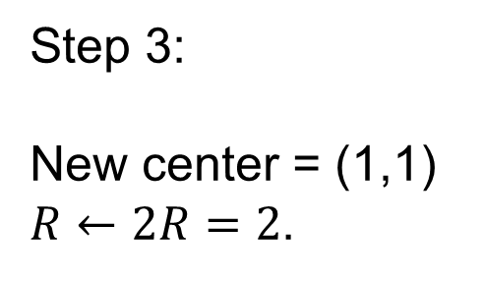
Iteration 2
Step 3:
New center = (1,1)
$R←2R=2$.
(3,3)
(1,1)
(0,0)
(-1,-1)

Slide 20
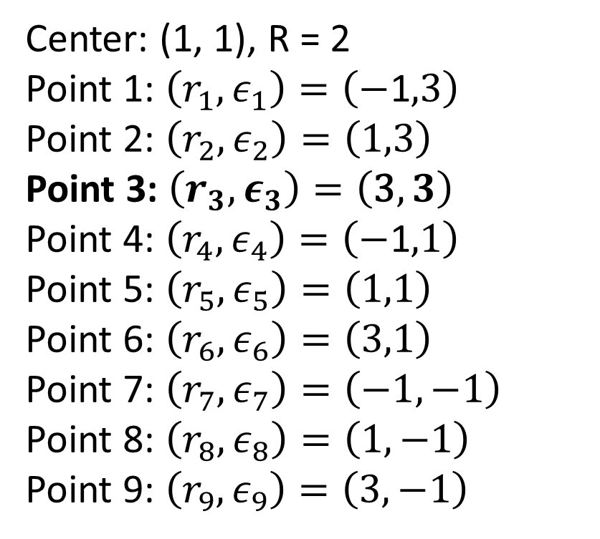

Iteration 3
Step 2
Center: (1, 1), R = 2
Point 1: $\left(r_{1},ε_{1}\right)=\left(−\text{1},\text{3}\right)$
Point 2: $\left(r_{2},ε_{2}\right)=\left(1,3\right)$
Point 3: $\left(r_{3},ε_{3}\right)=\left(\text{3},3\right)$
Point 4: $\left(r_{4},ε_{4}\right)=\left(−\text{1},1\right)$
Point 5: $\left(r_{5},ε_{5}\right)=\left(1,1\right)$
Point 6: $\left(r_{6},ε_{6}\right)=\left(\text{3},1\right)$
Point 7: $\left(r_{7},ε_{7}\right)=\left(−\text{1},−\text{1}\right)$
Point 8: $\left(r_{8},ε_{8}\right)=\left(1,−1\right)$
Point 9: $\left(r_{9},ε_{9}\right)=\left(\text{3},−1\right)$
Loss 1$=0.64$
Loss 2$=0.35$
Loss 3$=0.07$
Loss 4$=1.34$
Loss 5$=0.34$
Loss 6$=2.02$
Loss 7$=0.34$
Loss 8$=1.34$
Loss 9$=3.02$
Loss $= \left|\cos\left(\frac{π}{3}\right)−r\left[(\sin\left(\frac{π}{3}+ε\right)−sin⁡(\frac{π}{3}−ε)\right]\right|$

Slide 21

3. Our new method
Complexity: $O(\log{N)}$

Slide 22
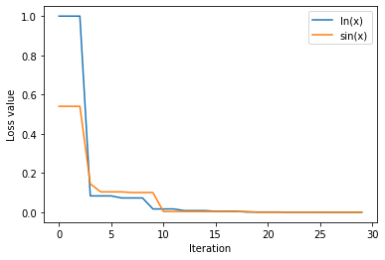
4. Results

Slide 23
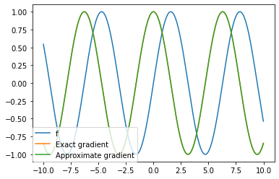
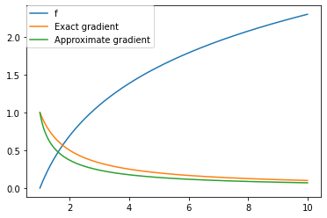


4. Results
$$f\left(x\right)=sin⁡(x)$$
$$f\left(x\right)=ln⁡(x)$$

Slide 24
Thanks for listening!

